Slide 1
Novel Support Vector Machines for Diverse Learning Paradigms
Gabriella Melki, PhD. Candidate, Virginia Commonwealth University
Advisor: Dr. Alberto Cano
Assistant Professor
Virginia Commonwealth University
Advisor: Dr. Sebastián Ventura
Professor
University of Córdoba
Notes:
Thank the committee for being here
Thank others as well
Today I'll present our current work + proposal for future work for my final phd dissertation which is based on developing novel svm…

Slide 2
Motivation

Slide 3
Traditional Supervised Learning

Slide 4
Multi-Target Learning

Slide 5
Multi-Instance Learning

Slide 6
Data Stream Learning

Slide 7
Contributions

Slide 8
Agenda

Slide 9
Multi-Target SVR using Maximum Correlation Chains
Notes:
Now, we will present our 3 contributions for the multi-target regression learning paradigm based on the idea of building chained regressors.
First, I'll give a brief background on some methods for solving this paradigm, then we will dive into the technicalities of my proposals
G. Melki et al. “Multi-target support vector regression via correlation regressor chains”. Information Sciences, vol. 415, pp. 53–69, 2017.

Slide 10
Multi-Target Learning
Problem Transformation vs Algorithm Adaptation
Linear Target Combinations for MT Regression
Multi-Objective Random Forests (MORF)
Classifier Chains:
RC, MTS, MTSC, ERC, and ERCC
Two stages of iterative learning:
Building single-target model on the next chain component
Use the knowledge gained by the previous component to predict the next target in the chain, while using possible relationships the targets might have with one another.
Notes:
There are two main approaches to multi-target learning, problem transformation and algorithm adaptation.
Problem transformation methods involve altering the MT problem into ST ones.
Algorithm adaptation methods involve modifying existing traditional algorithms to predict all the target variables simultaneously.
It is known that algorithm adaptation methods outperform problem transformation methods. The most valuable advantage of using AA is that, not only are the relationships between the sample variables and the targets exploited, but the relationships between the targets amongst themselves are as well.
One approach for AA in the context of classification are the idea of classifier chains
Examples of these include...
Chaining usually involve 2 stages:
Building an ST model
Using knowledge gained by first step to predict remaining targets, while using correlations.
We decided to utilize this chaining idea and apply it to regression using SVRs
Although these methods seem similar in nature, there are fundamental differences

Slide 11
Base-Line Multi-Target SVR
Notes:
The base model is the SVR model, where m single-target non-linear support vector regressors (NL-SVR) are built for each target variable Yj
Describe figure
The reason behind this method:
Evaluate the performance of ST-SVM against the other SOA methods
Evaluate it as a base-line method for the purpose of observing the improvements of our chained methods against a ST method

Slide 12
SVR with Random Chains (SVRRC)
Notes:
This brings us to our second contribution, inspired by ERCC, SVRRC.
Describe
Here the dataset is not split, but rather the model is adapted to the various target outputs
The adaptation stems from model chaining
So, what constitutes building a chained model?
Describe using the figure
[Difference between us and ERCC]
In ERCC, their chained model consists of chaining the predicted target values from the previous step, for SVRRC, we opted against that and used the true target outputs in order to minimize error propagation during the chaining process
This method was fine, but we worried that that randomly generated chains might not maximally capture the target’s correlations. That brings us to our next proposal.
4 targets > 10 chains

Slide 13
SVR max-Correlation Chain (SVRCC)
Notes:
This contribution builds a single chained regressor in the direction of maximum correlation among the target variables
The idea behind this is to build a single chain that captures the targets correlations properly
This ensures that using the target as input for the next positively contributes towards learning
We first calculate the correlation coefficient matrix for the target variables,
take the row-wise sum of absolute value,
sort them in decreasing order, and
use the indices as the max-corr chain

Slide 14
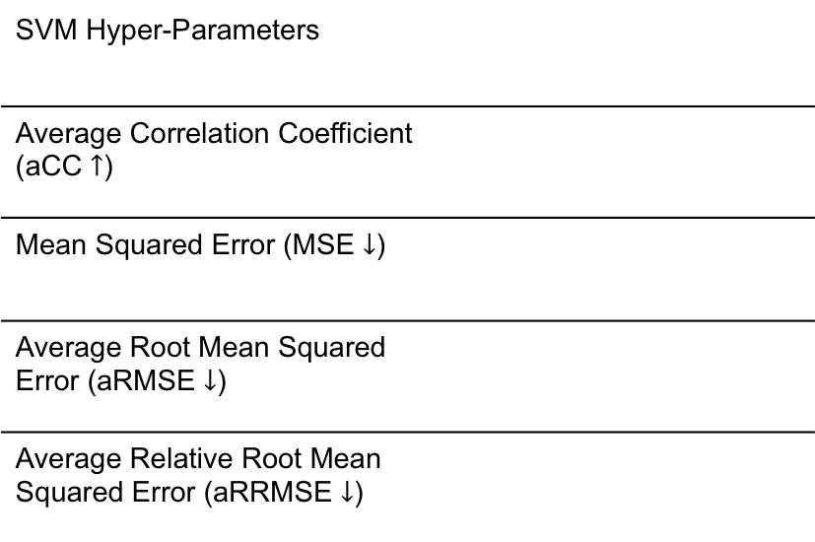
Experimental Environment
SVM Hyper-Parameters
Average Correlation Coefficient (aCC $↑$)
Mean Squared Error (MSE $↓$)
Average Root Mean Squared Error (aRMSE $↓$)
Average Relative Root Mean Squared Error (aRRMSE $↓$)
Notes:
Algorithm comparison with the popular methods mentioned previously because framework is readily available: RC, ST, MTS, MTSC, ERC, ERCC, and MORF
Developed our novel SVRs in MULAN’s framework of MTRgressor, which was built on top of weka. and used the recommended parameters for each of the methods compared
The following are the metrics used
rigorous statistical analysis was performed as well but for the sake of time, we will only report the bonf-dunn with critical difference value with 95% confidence
The ST base-line model used was Bagging of 100 regression trees.
The MTSC and ERCC methods are run using 10-fold cross-validation, and the ensemble size for the ERC and ERCC methods was set to 10.
The ensemble size of 100 trees was used for MORF, and the rest of its parameters were set as recommended by Kocev et al. “Tree ensembles for predicting structured outputs”. In: Pattern Recognition 43 (2013), pp. 817–833.

Slide 15
Results
Notes:
All proposals 17 out of the 24 datasets
SVR performs the best on 1 / 17
SVRRC 5 / 17
SVRCC performs the best on 11 / 17
These results complement our initial hypothesis that chaining does in fact improve the performance of the classifier

Slide 16
Results
Notes:
Here the results indicate that the ST methods are the fastest, which makes sense because they are neither ensembles nor chained classifiers.
Talk about how SVRCC is competitive against the ST methods
Not only is it competitive in terms of performance, but it is also competitive in terms of time

Slide 17
Multi-Target Regression Conclusions
Results show the superior performance of using the SVR method as a base-line model, rather than regression trees as used in MORF.
SVRRC’s results highlighted the importance exploiting relationships among the target variables during training.
The results show the superiority of using the SVRCC method:
Ranked the best in all quality metrics and second best in terms of run time.
SVRCC performed better than the two other contributions proposed
This shows that the targets’ maximum correlation does positively contribute toward model training
Significant differences exist between the proposed algorithms against the methods compared.

Slide 18
Multi-Instance SVM using Bag Representatives
Notes:
Now I would like to present our contribution towards the Multiple-Instance learning paradigm, a MI SVM for classification using bad-representatives
G. Melki, A. Cano, and S. Ventura. “MIRSVM: Multi-Instance Support Vector Machine with Bag Representatives”. Pattern Recognition, vol. 79, 228-241, 2018.

Slide 19
Multi-Instance Learning
Dietterich et. al. / Standard MI Assumption:
A bag is labeled positive if and only if at least one of the instances in the bag is positive, and is labeled negative otherwise
Instance Level Paradigm
MIOptimalBall, MIBoost, MISVM, MIDD, and MIWrapper
Bag Level Paradigm
MISMO, SimpleMI, miGraph, and TLC
Notes:
As mentioned previously, MIL is the learning paradigm where samples are considered bags, which contain multiple instances, and each bag is associated with a label.
This bag-level label is assigned by some MI assumptions, and the one that is within the scope of this work is the SMI.
The SMI Assumption states that…
There are several approaches to solving the MIL problem, two of those include the Instance level paradigm and bag level paradigm.
Instance level paradigm: aim to separate instances in positive bags from those in negative ones
Bag level paradigm: treat each bag as a whole entity, implicitly extracting information from each bag in order to accurately predict their labels
For our approach, we were inspired by MISVM, proposed by Andrews et. al.
It is a mixed-integer quadratic program that solves the MI problem at an instance-level, using a support vector machine, & is solved heuristically.
It tries to identify the key instance from each positive bag that makes the bag positive by assuming it has the highest margin value.
Instances from positive bags are selected as bag-representatives, and the algorithm iteratively creates a classifier that separates those representatives from all instances from the negative bags.
A disadvantage of this approach stems from the assumption that all instances within positive bags are also positive, which is an implicit step in the initialization of MISVM as well as its subsequent iterations.
The way we aimed to remedy this class imbalance problem is to restrict the instances in the negative class as well.

Slide 20

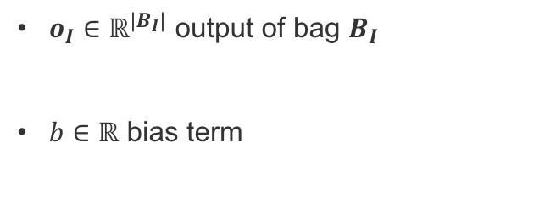
MIRSVM: Formulations
Primal
Dual
$S$ vector of bag representative indices
$x_{S_{I}}$ representative instance of bag $B_{I}$
$o_{I}∈ℝ^{|B_{I}|}$ output of bag $B_{I}$
$b∈ℝ$ bias term
G. Melki et al. “MIRSVM: Multi-Instance Support Vector Machine with Bag Representatives”. Pattern Recognition, vol. 79, 228-241, 2018.
Notes:
MIRSVM is based on the idea of selecting representative instances from both positive and negative bags which are used to find an unbiased, optimal separating hyperplane.
What we did was first reformulate the L1-SVM problem to optimize over bags rather than instances, as shown
A representative is iteratively chosen from each bag, and a new hyperplane is formed according to these new selected representatives until they converge.
Based on the SMI hypothesis, only one instance in a bag is required to be positive for the bag to adopt a positive label.
In other words, the most positive instance is chosen from each positive bag and the least negative instance is chosen from each negative bag (instances with the largest output value based on the current hyperplane)
These representatives are stored in SI
xsi ...
what we opted to derive and solve the dual problem using a QP solver
the following equations represent the calculation for the output and bias terms for the dual

Slide 21
MIRSVM: Algorithm

Slide 24
Online SVM using Worst-Violators

Slide 25
OLLAWV for Batched Data Streams

Slide 26
Conclusions

Slide 27
Future Work

Slide 28
Publications
[1] G. Melki, A. Cano, V. Kecman, S. Ventura. “Multi-target support vector regression via correlation regressor chains”. Information Sciences, vol. 415-416, pp. 53–69, 2017.
Impact Factor: 4.832
Quartile: Q1
[2] G. Melki, A. Cano, and S. Ventura. “MIRSVM: Multi-Instance Support Vector Ma- chine with Bag Representatives”. Pattern Recognition, vol. 79, pp. 228-241, 2018.
Impact Factor: 4.582
Quartile: Q1

Slide 29
Publications
G. Melki, A. Cano, V. Kecman, S. Ventura. “Multi-target support vector regression via correlation regressor chains”. Information Sciences, vol. 415-416, pp. 53–69, 2017.
Impact Factor: 4.832
Quartile: Q1

